Slide 1
Azure деплоймент
Денис Холод
www.intapp.com

Slide 2
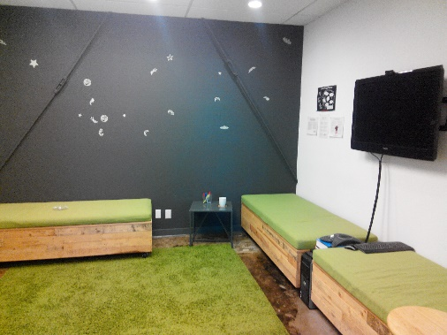
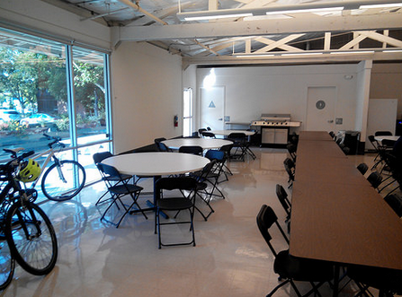
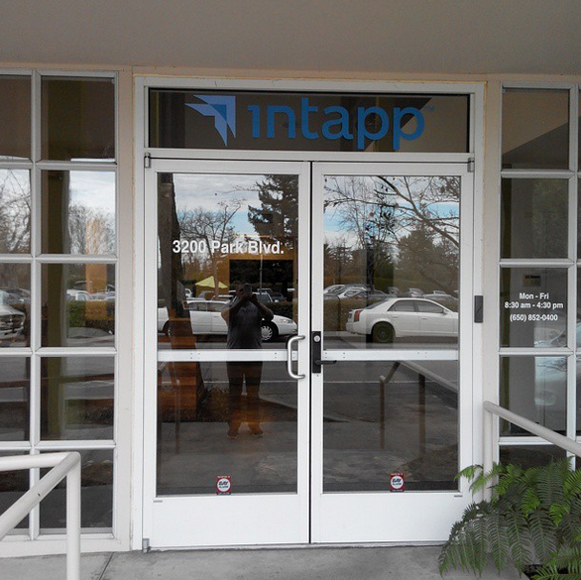
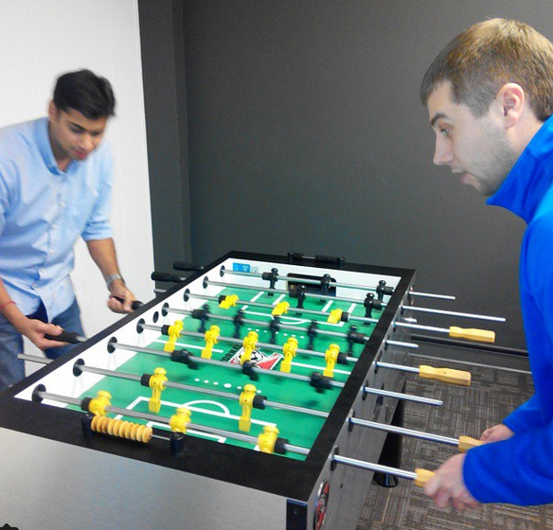
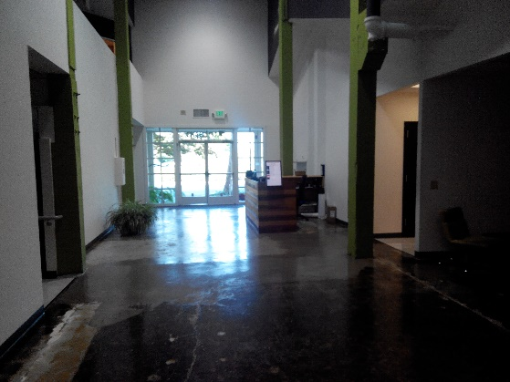
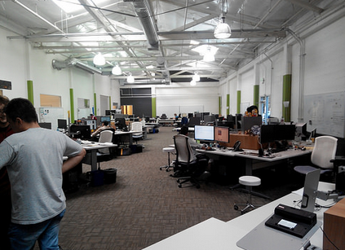
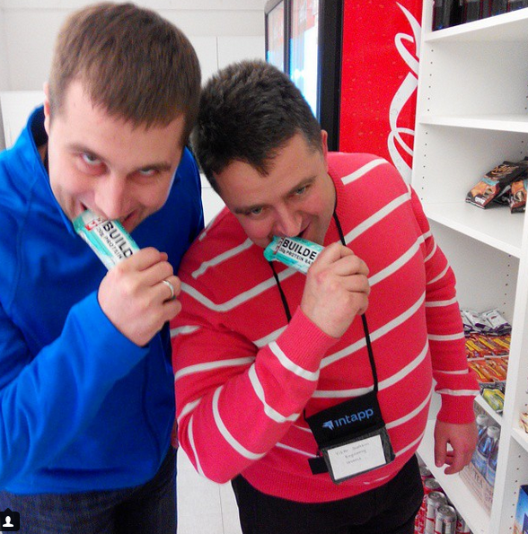
About Intapp

Slide 3
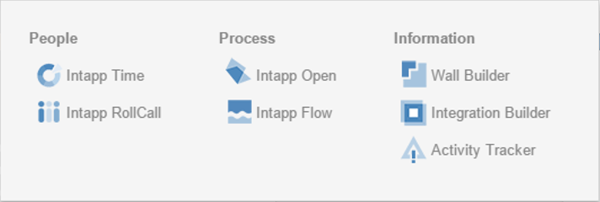
About Products

Slide 4
Deployment requirements
Deploy/teardown infrastructure – networks, storage, VMs,…
Deploy/teardown app services – master data sources, roles, DBs.
Any developer or QA can deploy own “cluster” within his own subscription
Pre-requirements setup > 10 min == fail
Everything is automated, easy integration with build systems
Options
Azure Service Management Cmdlets
Azure Resource Manager Cmdlets

Slide 5
Демо
Script run

Slide 6
Step 0. Select deployment subscription
Import-AzurePublishSettingsFile <publishsettingsPath>
Select-AzureSubscription -SubscriptionName <subscriptionName> –Default

Slide 7
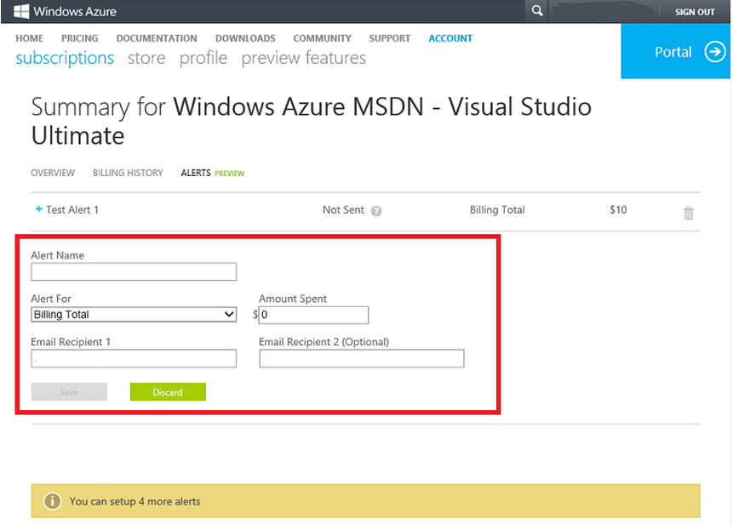
Billing alerts

Slide 8
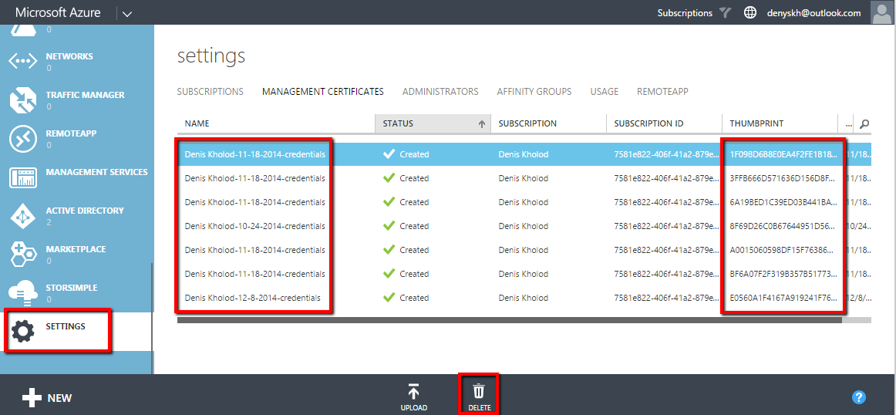
Revoke the certificate

Slide 9
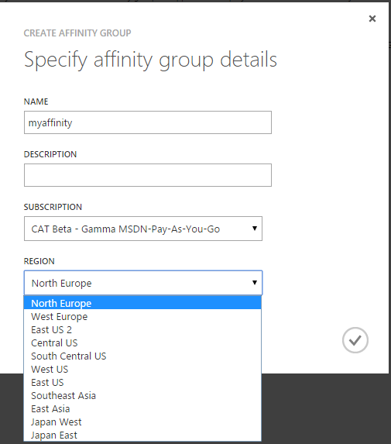
Step 1. Create-AffinityGroup
New-AzureAffinityGroup

Slide 10
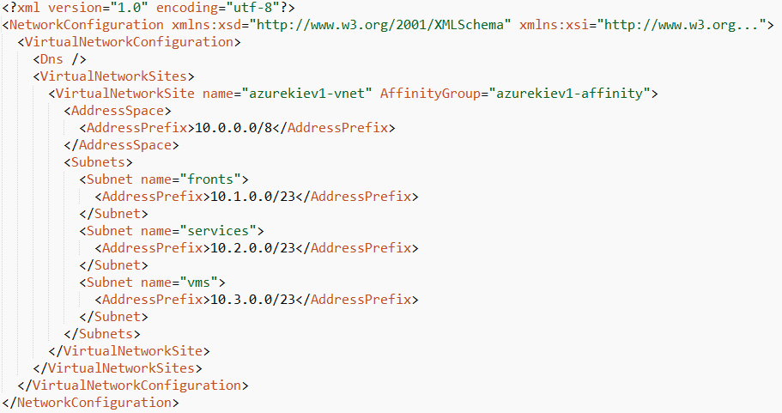
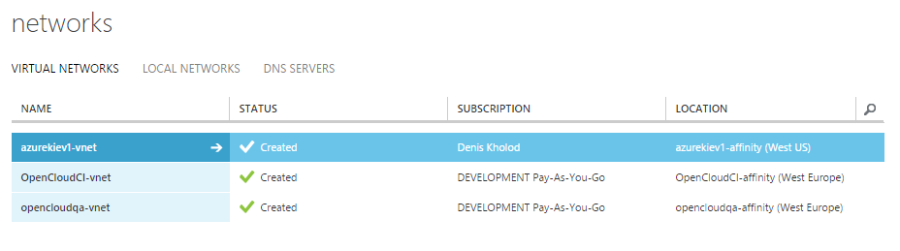
Step 2.Create-Network
Get-AzureVNetConfig -ExportToFile <fname>
Set-AzureVNetConfig -configurationpath <fname>

Slide 11
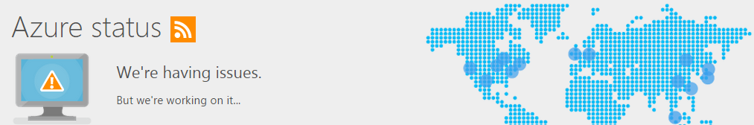
Step 3. Create Storage
New-AzureStorageAccount -StorageAccountName <storageName> -AffinityGroup <affinityName>
http://azure.microsoft.com/en-us/status/

Slide 12
Step 4. Create VM
$imageName = ( Get-AzureVMImage | Where-Object { $_.Label -like $vmImageName } | Select -ExpandProperty ImageName )[0]
New-AzureQuickVM …
-ImageName $imageName -AvailabilitySetName <availabilitySetName>

Slide 13
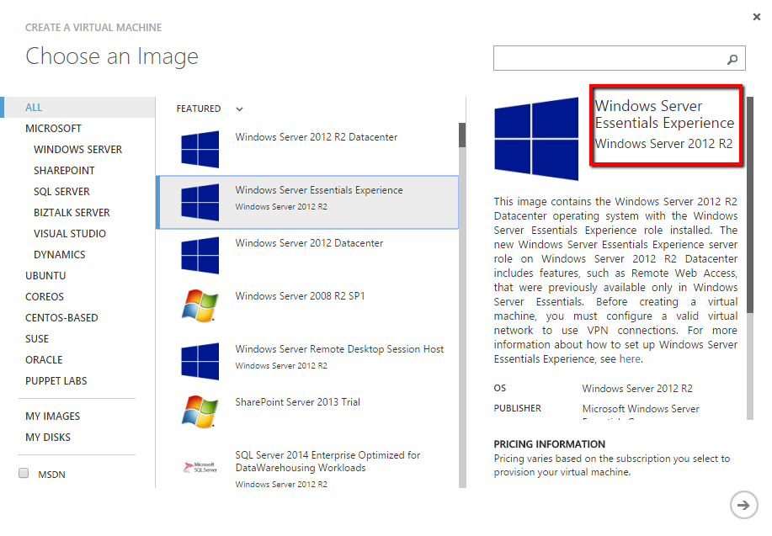
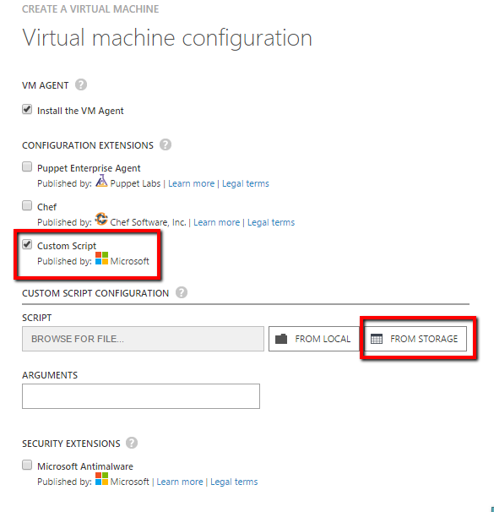
Step 4. Create VM

Slide 14
Other steps
New-AzureService -AffinityGroup <affinityName> -ServiceName <cloudServiceName>
Add-AzureCertificate -serviceName <ServiceName> -certToDeploy <certificatePath> -password <password>
New-AzureDeployment -ServiceName <ServiceName> -Slot ‘Staging’ -Package <local path or path to blob> -Configuration <config file>
Warm-Up $request = [System.Net.HttpWebRequest]::Create($url) $request.set_Timeout([Timespan]::FromMinutes(5).TotalMilliseconds) $response = $request.GetResponse()

Slide 15
Демо
What was deployed

Slide 16
From backlog
Parallel deployment to improve time
Deployment artifacts in Azure blobs (packages, tools, etc) as part of CI build
Azure Automation

Slide 17
Вопросы
Denys Kholod
denyskh@gmail.com

